Slide 1


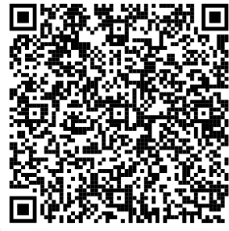


Is your child starting school in September 2025?
Your child starting school may feel a million miles away or just around the corner. It is never too early or too late to start thinking about preparing for school and the skills your child may need.
Thursday 19th June 2025
2-3.15pm
at
Awbridge Primary School
SO510HL
Book your FREE place via the QR code
hhf@barnardos.org.uk
@hampshire_healthy_families

